Slide 1
Twin OR ontology

Slide 2
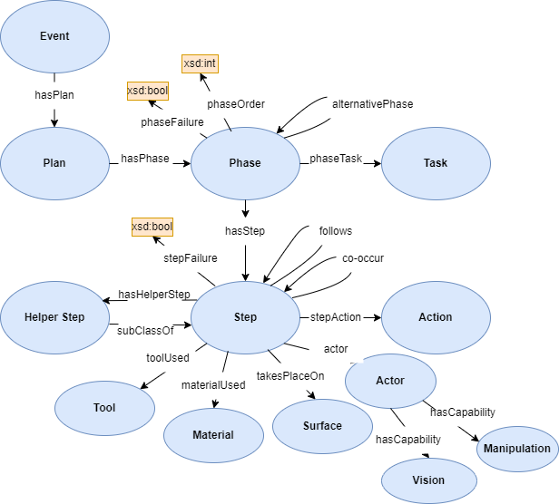
OR ontology
Notes:
properties specific to surfaces and materials are omitted
<number>

Slide 3
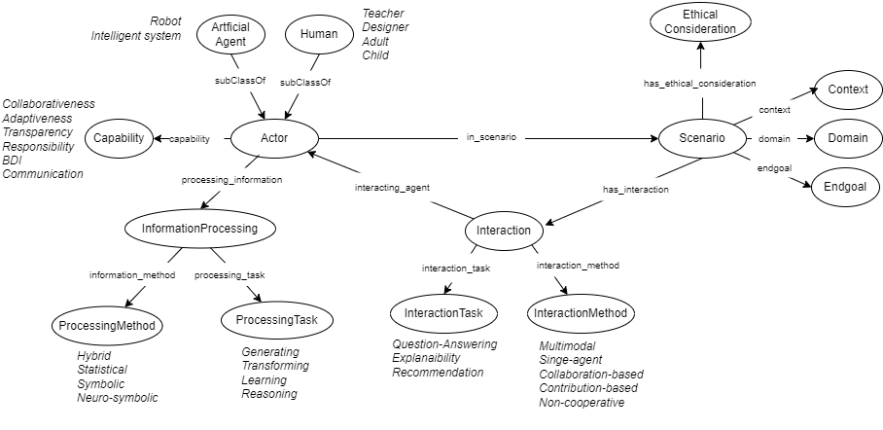
HI ontology

Slide 4
Alignment (OR with HI)
or:Actor subClassOf hi:Actor
or:Capability subClassOf hi:Capability
or:event skos:broader hi:scenario
Notes:
What expressiveness does this yield? Try in protege
<number>

